Slide 1

Password Cracking
John the Ripper
Presented By : Kachi & KK

Slide 2

About John the Ripper
John the Ripper (JtR) is a:
- Free, open-source password cracking tool.
- Used for testing password strength.
- Supports many platforms like Linux, Windows, and macOS.
Features:
- Supports hash types (MD5, SHA-1, NTLM).
- Extensible via community modules.

Slide 3
How John the Ripper Works
Types of Attacks Used by John the Ripper:
1. Dictionary Attack: Uses a predefined list of passwords.
2. Brute-Force Attack: Tries all possible combinations.
3. Hybrid Attack: Combines dictionary and brute-force methods.
Key Feature: Configurable rules for customizing attacks.

Slide 4
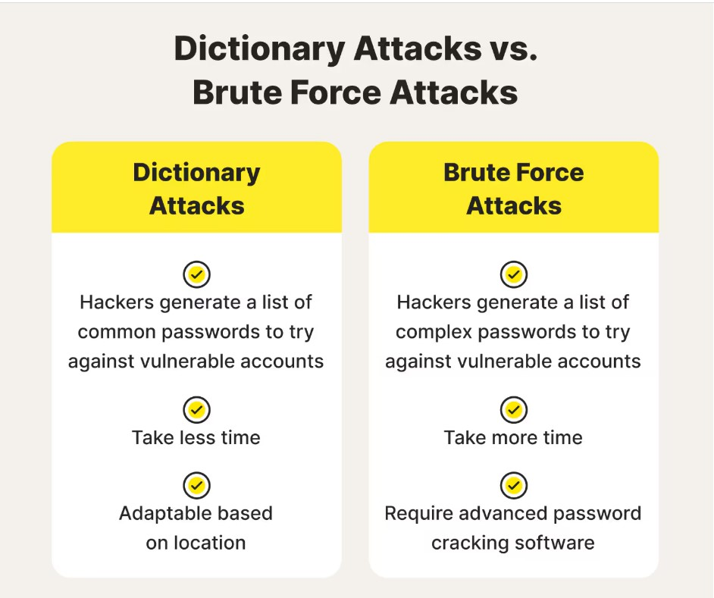

Slide 5
Ethical and Legal Implications
Always follow ethical guidelines:
- Obtain explicit permission before testing passwords.
- Use for authorized penetration testing or research purposes.
Legal Consequences of Unauthorized Use:
- Breach of privacy laws.
- Severe penalties under computer misuse acts.

Slide 6
Limitations of John the Ripper
Challenges JtR Faces:
- Struggles with long and highly complex passwords.
- Limited effectiveness against modern encryption techniques.
- Computationally expensive for brute-force attacks.
Success Comparison :
Simple Password (e.g., 1234): Seconds - High Success
Complex Password ($Tr0ngP@ss!): Hours/Days - Low Success

Slide 7
Conclusion
Key Takeaways:
- John the Ripper is a powerful tool for ethical hacking.
- Highlights the importance of strong password practices.
- Use responsibly to improve cybersecurity, not exploit vulnerabilities.
A strong password is your first defense; keep it secure.

